Slide 1
TextRank: Bringing Order into Texts
Arian Tashakkor – Shahab Mohrehkesh

Slide 2
Presentation Structure
Introduction
Background of Graph
The TextRank Model
Text as a Graph
Keyword Extraction & Sentence Extraction
Experiments
Why TextRank Works
Conclusion
References

Slide 3
Introduction

Slide 4
Introduction
HITS algorithm or Google’s PageRank have been successfully use in:
Citation analysis
Social networks
Analysis of the link structure of the World Wide Web
Graph-based ranking model that can be applied to a variety of natural language processing applications
Automated Extraction of Keyphrase
Extractive Summarization

Slide 5
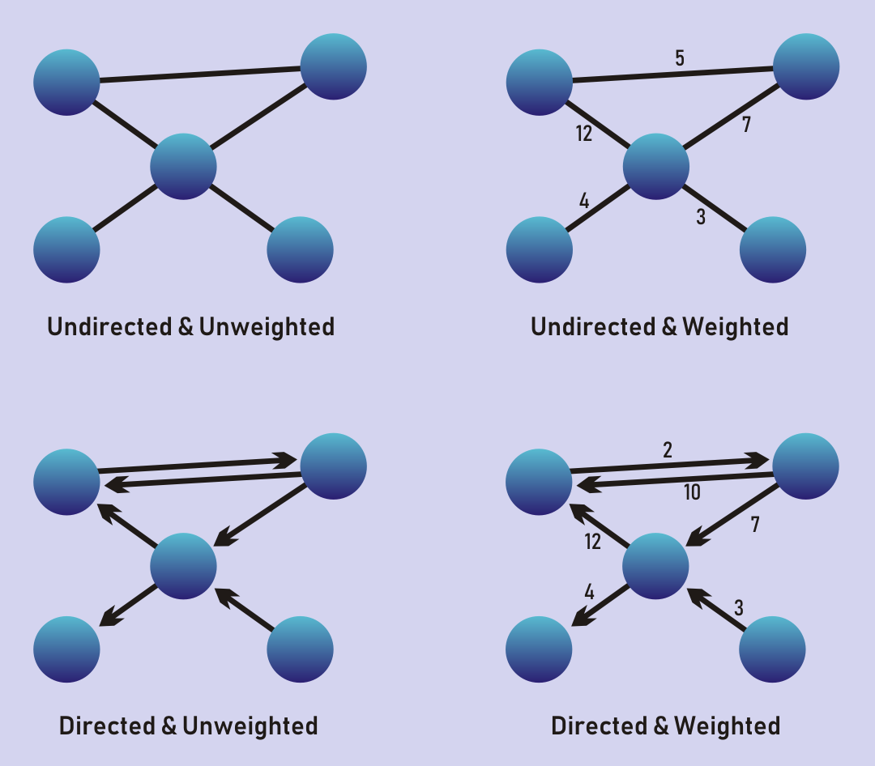

Background of Graph
$G=\left(V,E\right)$ directed graph , for $V_{i}$:
$In$($V_{i}$):
be the set of vertices that point to it (predecessors)
$Out$($V_{i}$):
be the set of vertices that vertex $V_{i}$points to (successors)

Slide 6
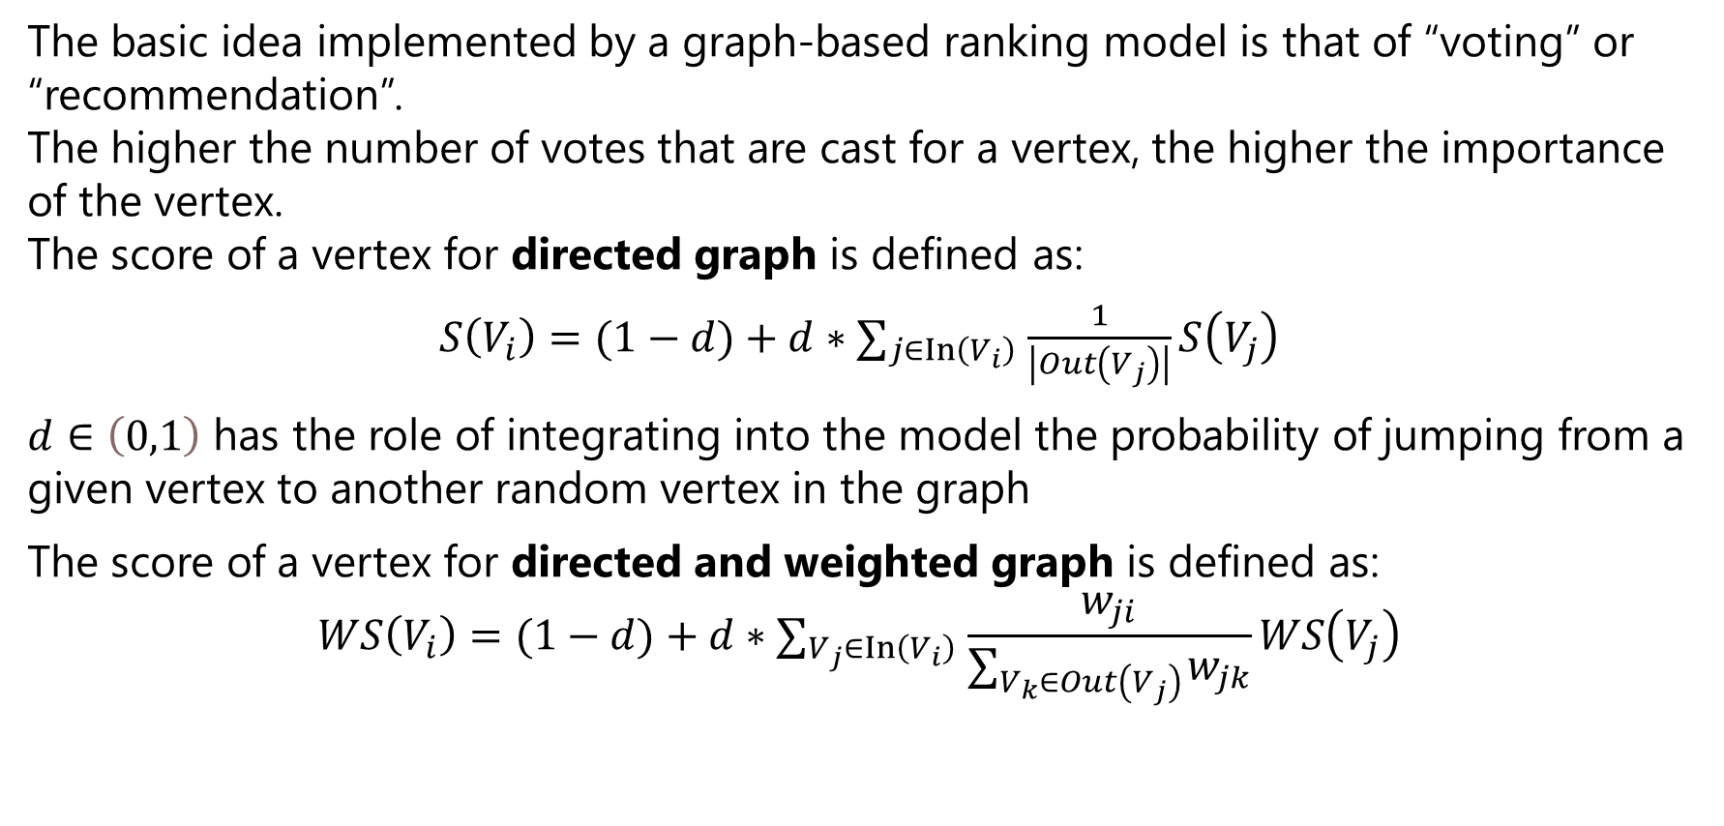
The TextRank Model
The basic idea implemented by a graph-based ranking model is that of “voting” or “recommendation”. The higher the number of votes that are cast for a vertex, the higher the importance of the vertex. The score of a vertex for directed graph is defined as:
$S\left(V_{i}\right)=(1−d)+d∗∑_{j∈In⁡\left(V_{i}\right)} \frac{1}{\left|Out\left(V_{j}\right)\right|}S\left(V_{j}\right)$
$d∈\left(0,1\right)$ has the role of integrating into the model the probability of jumping from a given vertex to another random vertex in the graph
The score of a vertex for directed and weighted graph is defined as:
$$WS\left(V_{i}\right)=(1−d)+d∗∑_{V_{j}∈In⁡\left(V_{i}\right)} \frac{w_{ji}}{∑_{V_{k}∈Out\left(V_{j}\right)} w_{jk}}WS\left(V_{j}\right)$$

Slide 7
How to convert Text to Graph

Slide 8
How to convert Text to Graph
text units of various sizes and characteristics can be added as vertices in the graph, e.g. words, collocations, entire sentences.
Type of relations that are used to draw connections between any two such vertices, e.g. lexical or semantic relations, contextual overlap.
The application of graph-based ranking algorithms to natural language texts consists of the following main steps:
Identify text units that best define the task at hand, and add them as vertices in the graph.
Identify relations that connect such text units, and use these relations to draw edges between vertices in the graph. Edges can be directed or undirected, weighted or unweighted.
Iterate the graph-based ranking algorithm until convergence.
Sort vertices based on their final score. Use the values attached to each vertex for ranking/selection decisions

Slide 9
Keyword Extraction & Sentence Extraction

Slide 10
Keyword Extraction

Slide 11
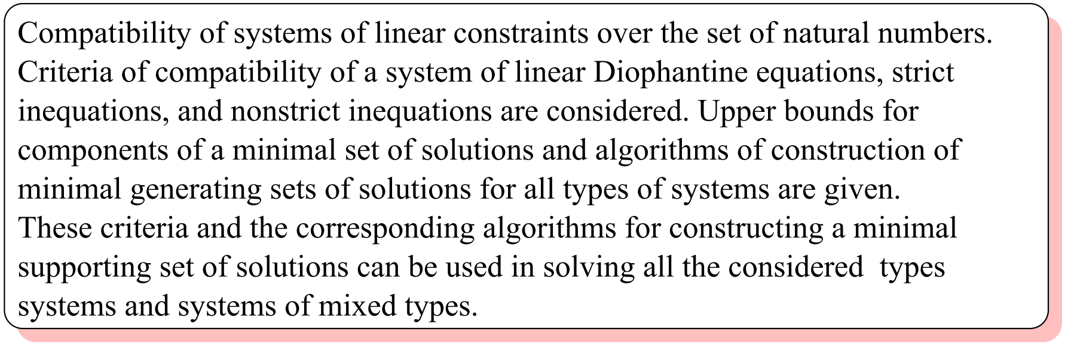
Keyword Extraction
The simplest possible approach is perhaps to use a frequency criterion to select the “important” keywords in a document
The state-of the-art in this area is currently represented by supervised learning methods, where a system is trained to recognize keywords in a text, based on lexical and syntactic features
A system for keyphrase extraction - GenEx(Turney, 1999)
A different learning algorithm Naive Bayes learning(Frank et al., 1999)
A supervised learning system to keyword extraction from abstracts, using a combination of lexical and syntactic features(Hulth, 2003)
Keyword extraction using TextRank

Slide 12
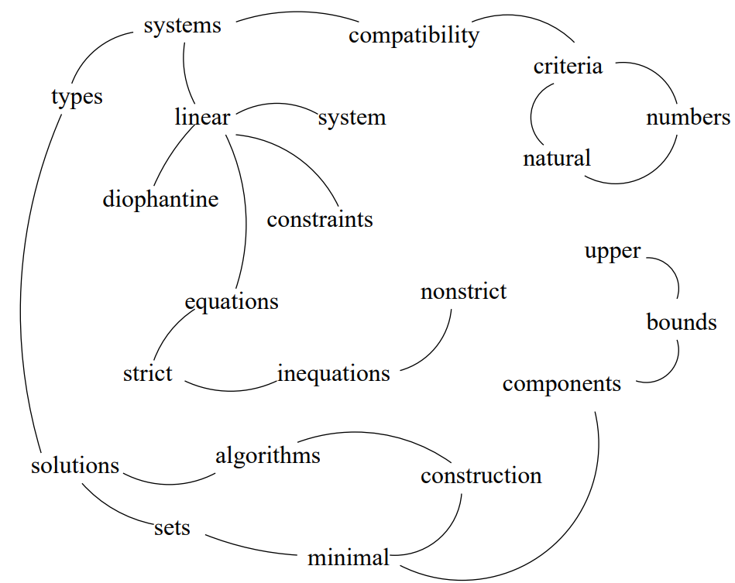
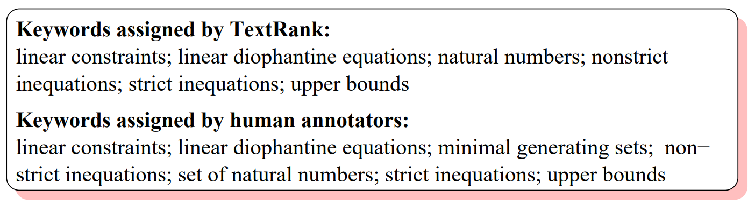
TextRank for Keyword Extraction
Two vertices are connected if their corresponding lexical units co-occur within a window of maximum words, where can be set anywhere from 2 to 10 words.

Slide 13
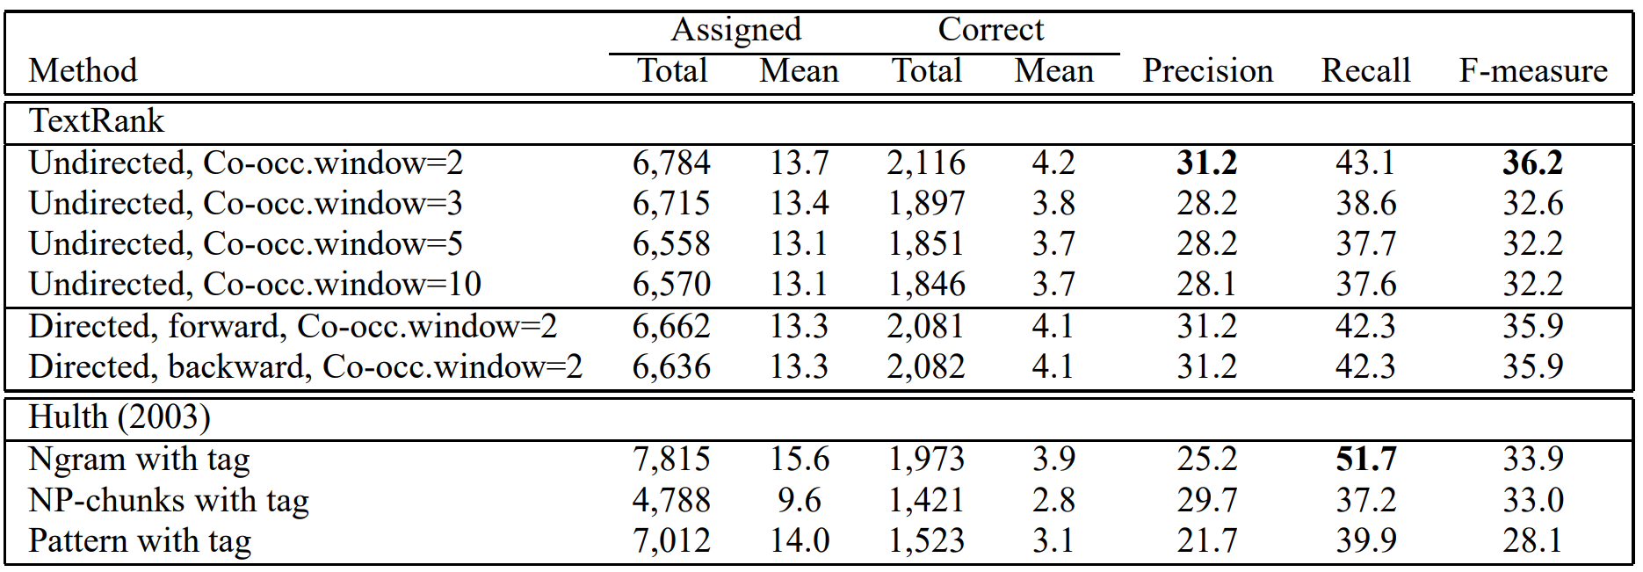
Evaluation for Keyword Extraction
Features for Hulth(2003):(1) within-document frequency, (2) collection frequency, (3) relative position of the first occurrence, (4) sequence of part of speech tags.
Various syntactic filters for TextRank:all open class words, nouns and adjectives, and nouns only (Dataset: Collection of 500 abstracts from the Inspec database)

Slide 14
Sentence Extraction

Slide 15
Sentence Extraction
Sentence extraction can be regarded in the same way as keyword extraction.
Where we had “words” and “phrases” as candidate text units during keyword extraction, we now have to deal with entire sentences.
Turns out that TextRank is well suited for this type of application too since it:
“allows for a ranking over text units is recursively computed based on information drawn from the entire text.”

Slide 16
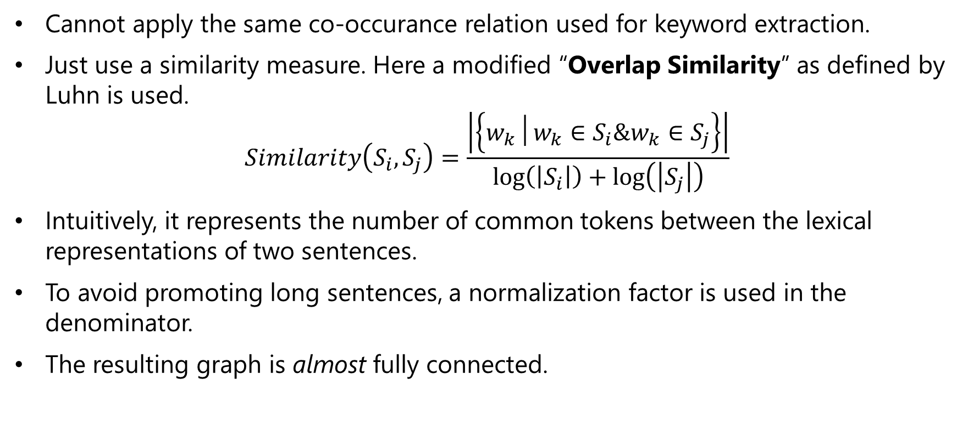
TextRank for Sentence Extraction
Cannot apply the same co-occurance relation used for keyword extraction.
Just use a similarity measure. Here a modified “Overlap Similarity” as defined by Luhn is used.
$$Similarity\left(S_{i},S_{j}\right)=\frac{\left|\left\{w_{k}│w_{k}∈S_{i}\&w_{k}∈S_{j}\right\}\right|}{\log\left(\left|S_{i}\right|\right)+\log\left(\left|S_{j}\right|\right)}$$
Intuitively, it represents the number of common tokens between the lexical representations of two sentences.
To avoid promoting long sentences, a normalization factor is used in the denominator.
The resulting graph is almost fully connected.

Slide 17
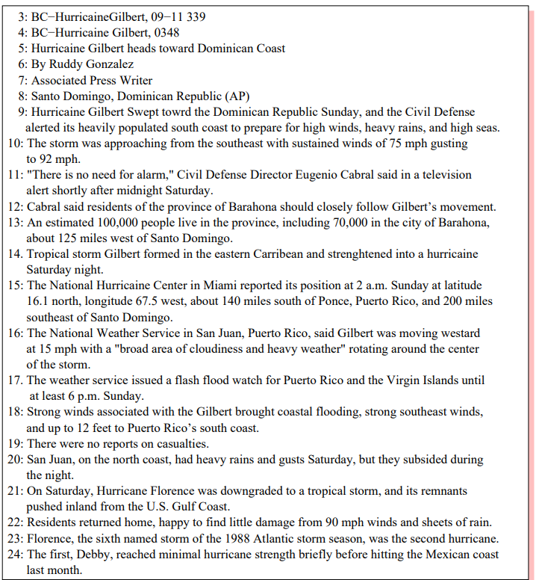
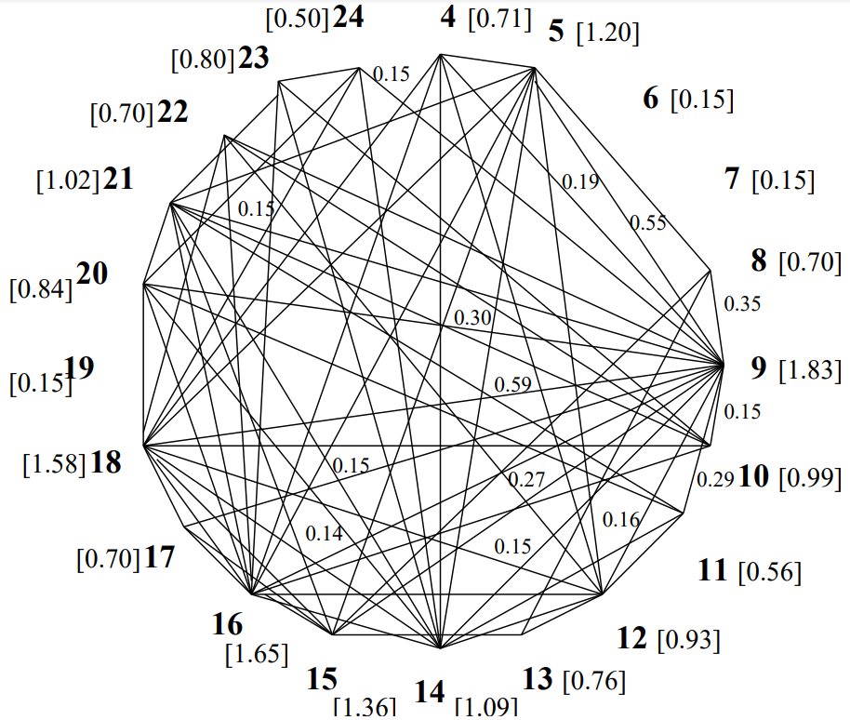
TextRank for Sentence Extraction

Slide 18
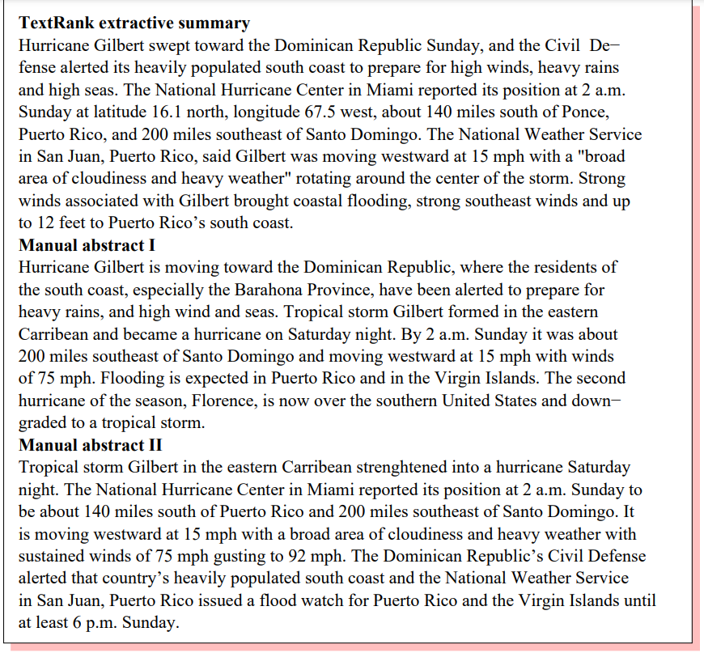
TextRank for Sentence Extraction

Slide 19
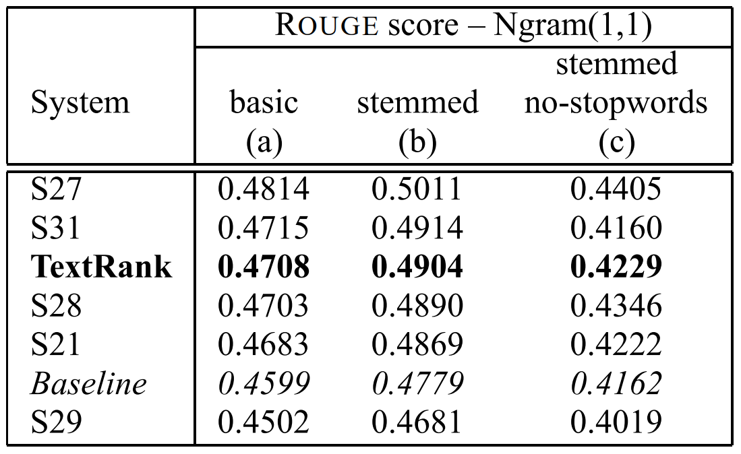
Evaluation for Sentence Extraction
Evaluation performed on 567 news articles from (DUC, 2002).
For each article, TextRank generates a 100-word summary, same as other systems participating in this single document summarization task.
ROUGE toolkit, specifically ROUGE1 is
used for evaluation with two manually
produced summaries used as reference.

Slide 20
Appendix: Effect of Different Similarity Measures

Slide 21
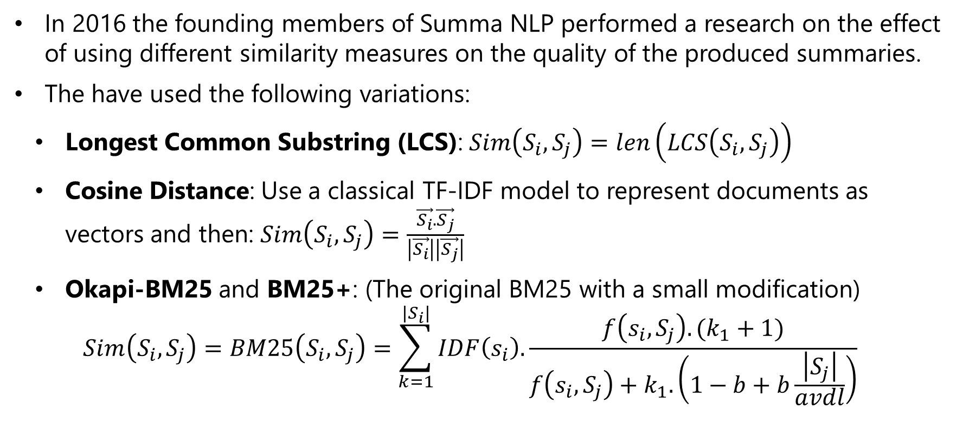
Effect of Different Similarity Measures
In 2016 the founding members of Summa NLP performed a research on the effect of using different similarity measures on the quality of the produced summaries.
The have used the following variations:
Longest Common Substring (LCS): $Sim\left(S_{i},S_{j}\right)=len\left(LCS\left(S_{i},S_{j}\right)\right)$
Cosine Distance: Use a classical TF-IDF model to represent documents as vectors and then: $Sim\left(S_{i},S_{j}\right)=\frac{\vec{S_{i}}.\vec{S_{j}}}{\left|\vec{S_{i}}\right|\left|\vec{S_{j}}\right|}$
Okapi-BM25 and BM25+: (The original BM25 with a small modification)
$$Sim\left(S_{i},S_{j}\right)=BM25\left(S_{i},S_{j}\right)=\sum_{k=1}^{|S_{i}|}{IDF\left(s_{i}\right).\frac{f\left(s_{i},S_{j}\right).(k_{1}+1)}{f\left(s_{i},S_{j}\right)+k_{1}. \left(1−b+b\frac{\left|S_{j}\right|}{avdl}\right)}}$$

Slide 22
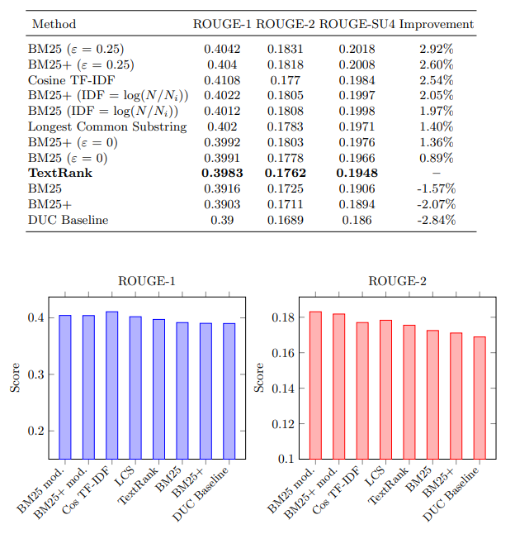
Effect of Different Similarity Measures
Best results obtained using BM25
and BM25+.
An improvement of 2.92% over
the original TextRank was achieved.
Performance in time also improved
All 567 documents from DUC2002
were processed in 84% of the time
needed in the original version.

Slide 23
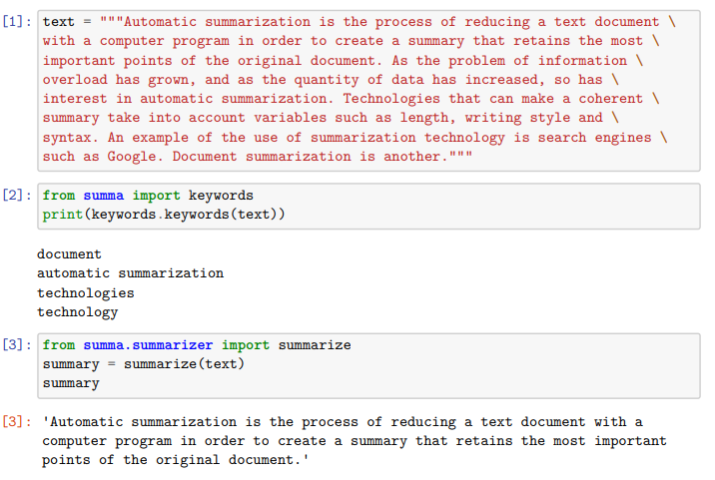
Experiments

Slide 24
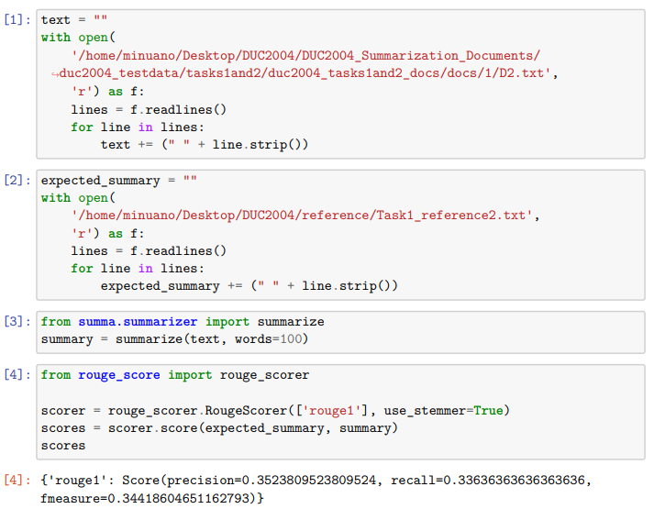
Experiments

Slide 25
Why TextRank Works

Slide 26
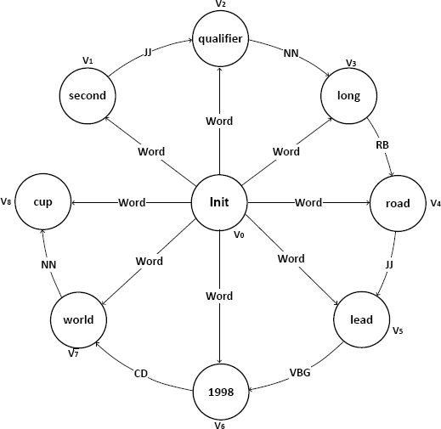
Why TextRank Works
Intuitively, TextRank works well because it does not only rely on the local context of a text unit (vertex), but rather it also takes into account information recursively drawn from the entire text (graph).
TextRank identifies connections between various
entities in a text, and implements the concept of
recommendation implicitly.

Slide 27
Why TextRank Works
TextRank, being an iterative mechanism, goes beyond simply graph connectivity, and is able to score text units based also on the “importance” of other text units they link.
The text units selected by TextRank for a given application are the ones most recommended by related text units in the text, with preference given to the recommendations made by the most influential ones.
I.e., the ones that are in turn highly recommended by other related units.
The main idea is that in a cohesive text fragment, related text units form a “Web” of connections that approximates the model humans build about a given context.

Slide 28
Conclusion

Slide 29
Conclusion
TextRank is a graph-based ranking model for text processing.
Two innovative unsupervised approaches for keyword and sentence extraction were proposed and evaluated.
It was shown that the accuracy achieved by TextRank in these applications is competitive with previously proposed state-of-the-art algorithms.
An important aspect of TextRank is that it does not require deep linguistic knowledge, nor domain or language specific annotated corpora, which makes it highly portable to other domains, genres, or languages.

Slide 30
References
Mihalcea, R., & Tarau, P. (2004, July). Textrank: Bringing order into text. In Proceedings of the 2004 conference on empirical methods in natural language processing (pp. 404-411).
Brin, S., & Page, L. (1998). The anatomy of a large-scale hypertextual web search engine. Computer networks and ISDN systems, 30(1-7), 107-117.
Kleinberg, J. M. (1999). Authoritative sources in a hyperlinked environment. Journal of the ACM (JACM), 46(5), 604-632.
Barrios, F., López, F., Argerich, L., & Wachenchauzer, R. (2016). Variations of the similarity function of textrank for automated summarization. arXiv preprint arXiv:1602.03606.

Slide 31
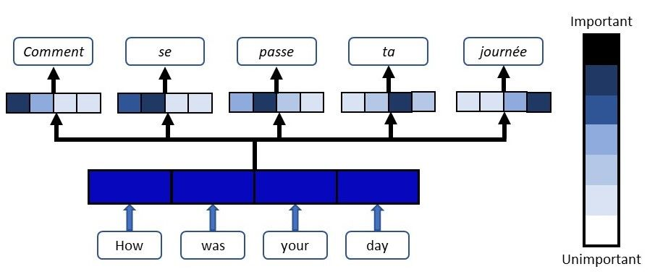
Thank you for your

